Slide 1
Internship Defence for Web Scraping
Presented By: Rabin Neupane(24109/076)

Slide 2
Introduction
Internship at: Prime Vendor Nepal Pvt. Ltd.
Overview:
Developed a web scraping solution using Java and Selenium.
Automated data extraction from multiple websites.
Ensured data integrity and managed storage with MySQL.
Objectives:
Apply theoretical knowledge to practical scenarios.
Enhance skills in Java, Selenium, and database management.
Tackle challenges in web scraping and data handling.

Slide 3
Problem Statement
Manual data extraction is tedious and time-consuming.
Websites frequently update and have diverse structures.
Anti-scraping measures hinder data extraction.
Dynamic content (JavaScript) complicates scraping.

Slide 4
Organization Details
Company: Prime Vendor Nepal Pvt. Ltd.
Founded: 2009
Specializes in: Python, Java-based projects, custom software solutions
Tech Stack: Java, Python, MySQL, etc.

Slide 5
Roles and Responsibilities
Role: Intern – Web Scraping Developer
Responsibilities
Develop web scraping scripts using Java and Selenium
Design and implement database schema for data storage
Integrate web scraping results with MySQL database
Perform data cleaning and preprocessing
Debug and handle errors in scraping scripts
Document and report project progress and results

Slide 6
Summary of Logs
Orientation & Setup: Attended sessions, met team, set up environment
Training: Learned web scraping, Java, and scripting basics
Script Development: Created and refined basic scraping scripts
Handling Websites: Analyzed layouts, developed scripts for different structures
Advanced Techniques: Learned dynamic content handling, used Selenium
Data Management: Cleaned and stored data, ensured data quality

Slide 7
Task Review: Implemented feedback, optimized scripts
Project Collaboration: Worked on larger project, participated in planning
Final Project Planning: Defined scope, started preliminary work
Development: Developed and tested final project
Completion & Presentation: Completed project, delivered presentation
Evaluation: Reviewed internship, finalized documentation

Slide 8
Project Description
Project: Development of web scraping solution using Java and Selenium
Scraping Scripts:
Automated data extraction using Java and Selenium WebDriver
Utilized XPath and CSS selectors for precise data targeting
Database Integration:
JDBC: Connected Java with MySQL
Schema Design: Structured tables for efficient data storage
Implemented SQL queries for data insertion and management

Slide 9
Tasks and Activities Performed
Writing and Debugging Code:
Developed web scraping scripts using Java
Utilized Selenium WebDriver for automation
Database Management:
Designed and implemented MySQL database schema
Connected Java applications to MySQL using JDBC
Inserted and managed data with SQL queries
Data Cleaning and Preprocessing:
Cleaned and formatted extracted data
Handled exceptions using try-catch blocks

Slide 10
Testing and Validation:
Conducted rigorous testing of scraping scripts
Validated data integrity by comparing with source websites
Error Handling and Logging:
Implemented try-catch blocks for error handling
Logged errors and exceptions for debugging
Collaboration and Documentation:
Worked with team members on project tasks
Documented project progress, methodologies, and results

Slide 11
Challenges and Solutions
Challenges:
Ensuring secure data handling
Implementing efficient database management
Solutions:
Enhanced problem-solving skills
Collaboration with mentors and peers

Slide 12
Internship outcome
Skills Gained:
Proficiency in Java and Selenium for web scraping
Experience in integrating Java applications with MySQL databases
Enhanced problem-solving and debugging skills
Understanding of data cleaning and preprocessing techniques
Impact:
Successfully automated data extraction processes
Improved data management and integrity
Developed practical skills applicable to real-world backend development

Slide 13
Conclusion
Summary:
Gained hands-on experience in web scraping and data management
Bridged theoretical knowledge with practical application
Developed valuable skills in backend development and database integration
Future Prospects:
Equipped with technical skills and experience for future projects and job opportunities
Prepared to tackle real-world challenges in data management and software development

Slide 14
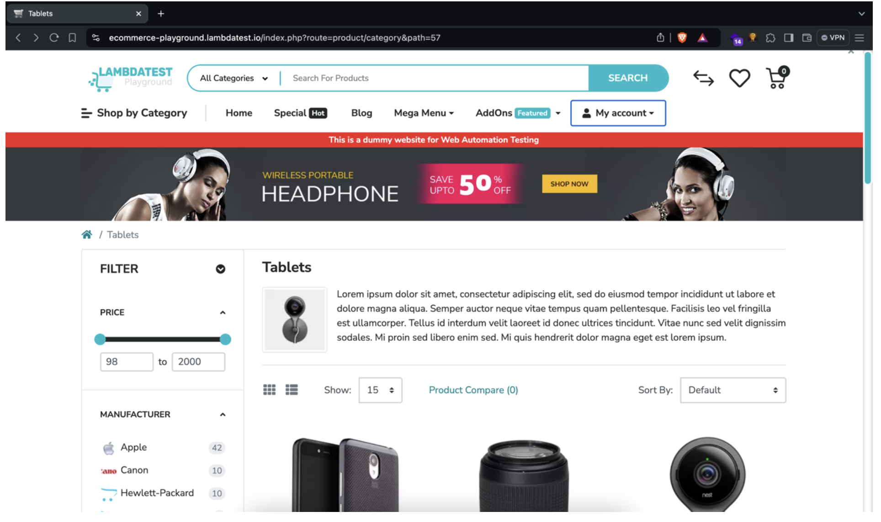
HomePage

Slide 15
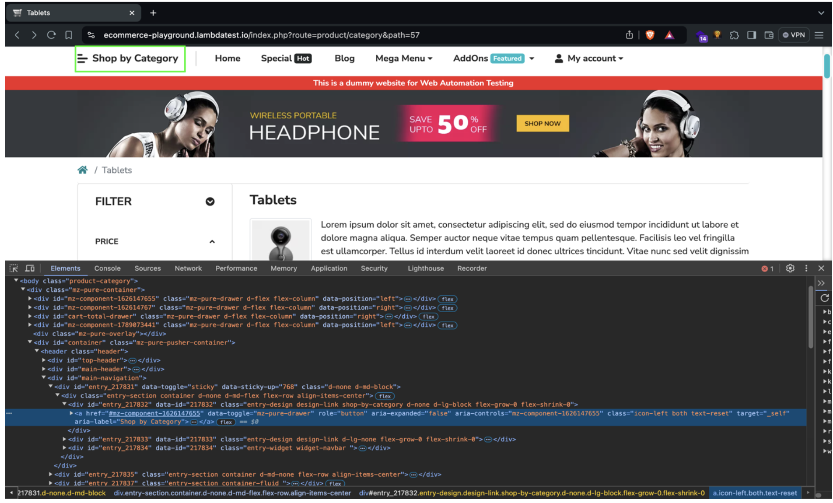
Selection of Category

Slide 16
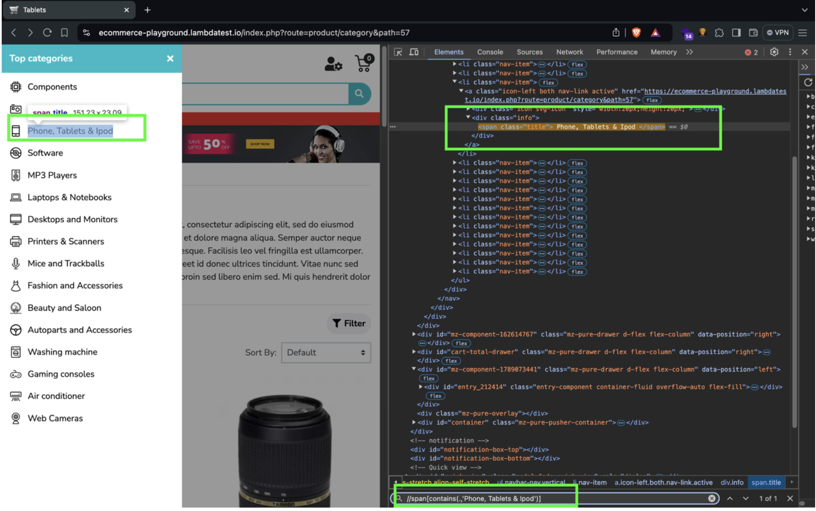
Select the Category Type

Slide 17
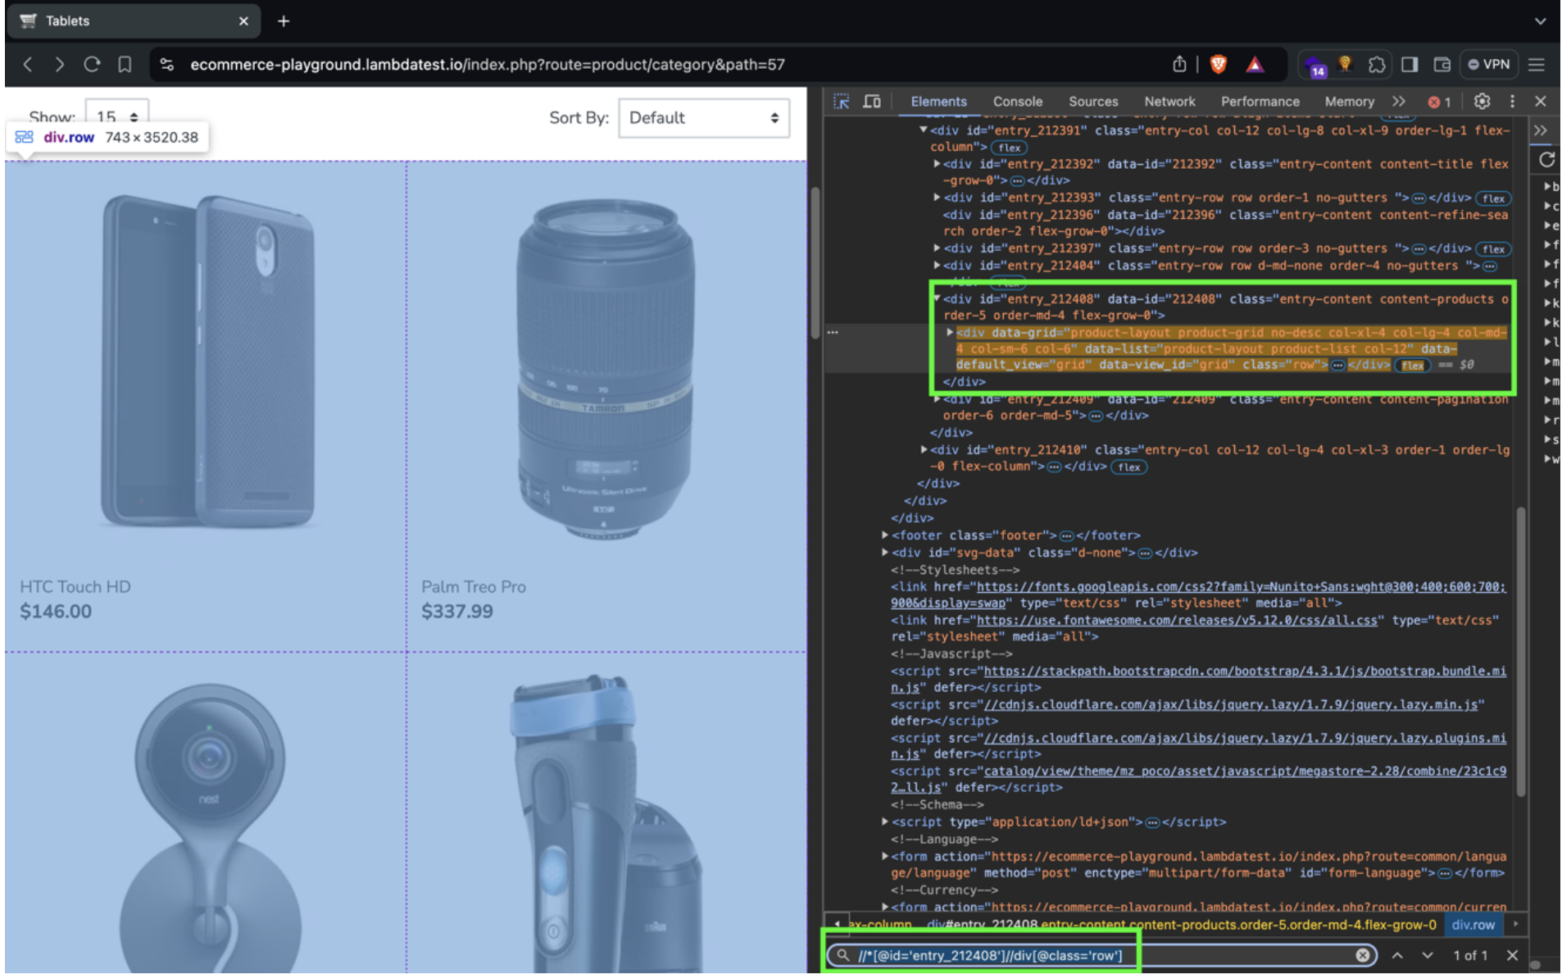
Load all the products

Slide 18
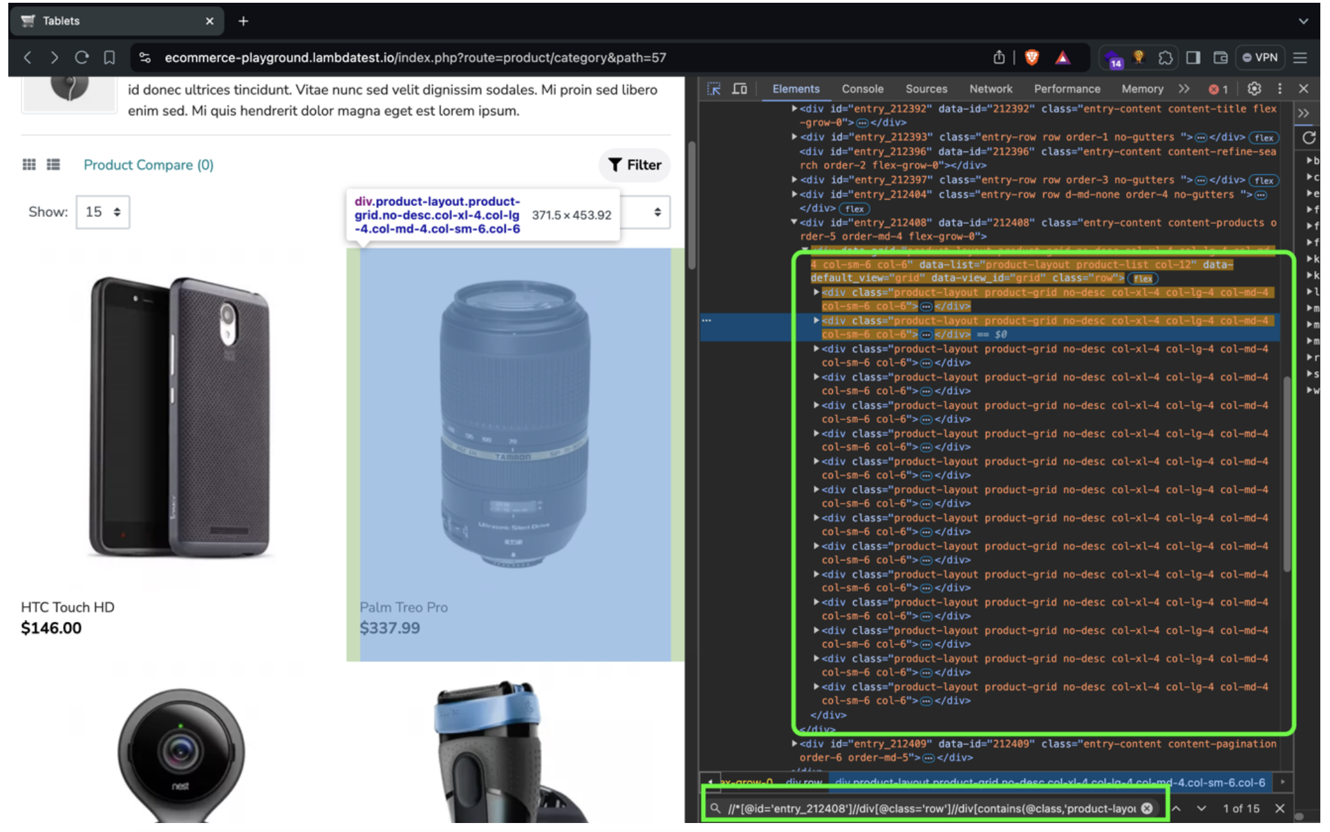
Select the Products

Slide 19
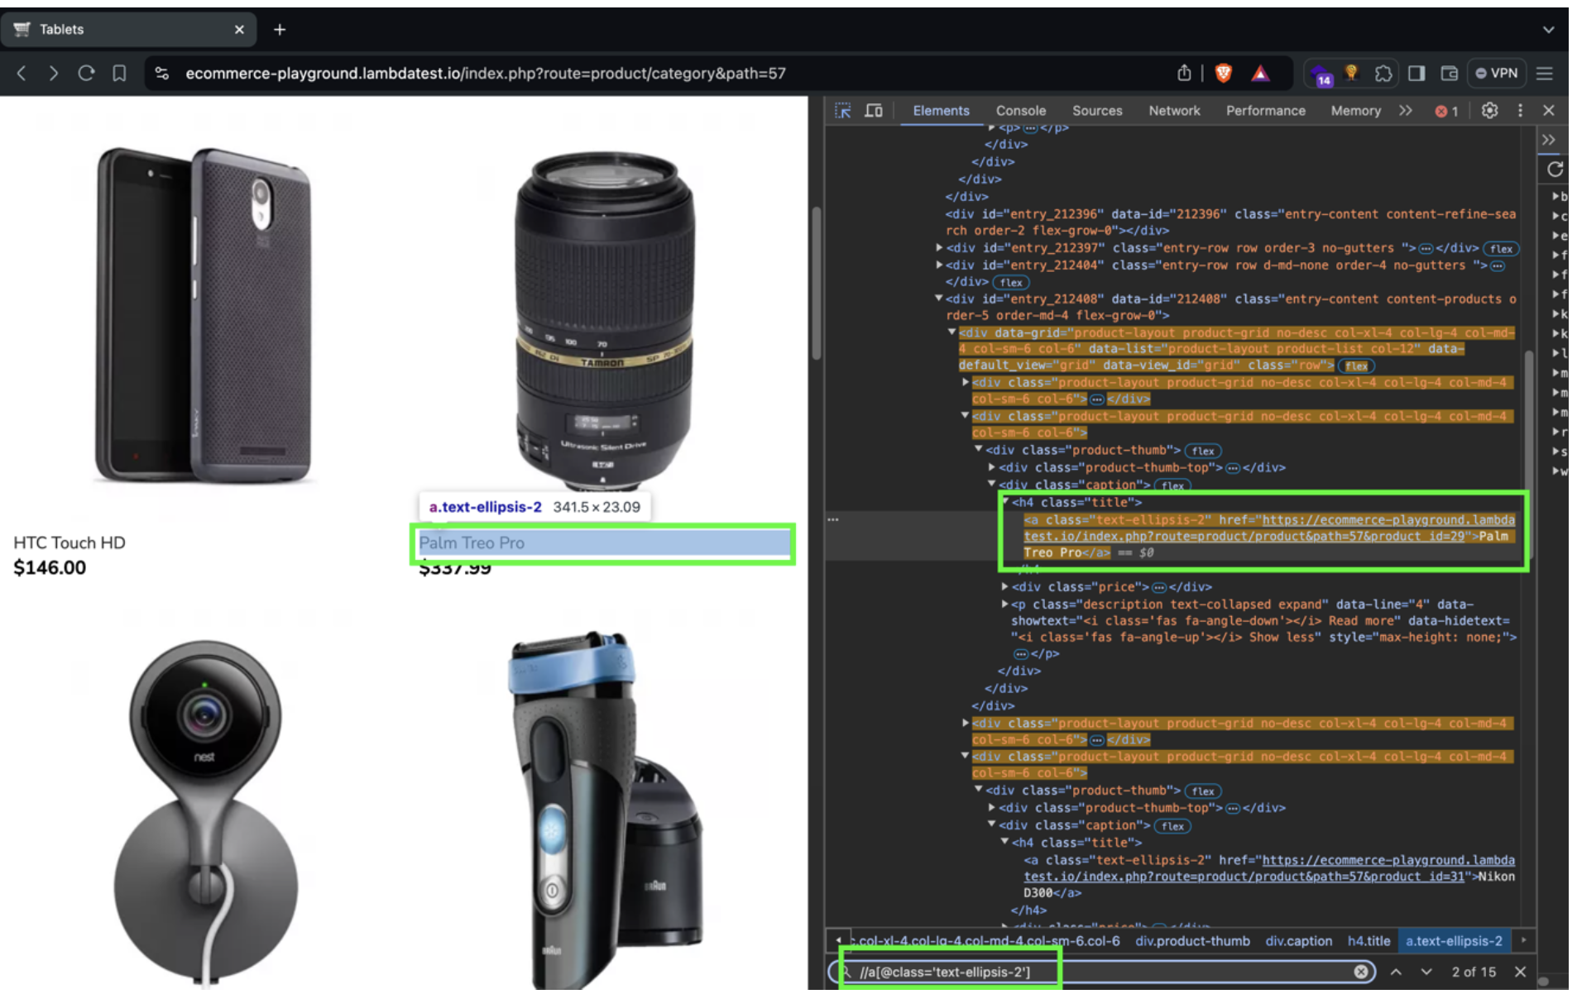
Select the Product Name

Slide 20
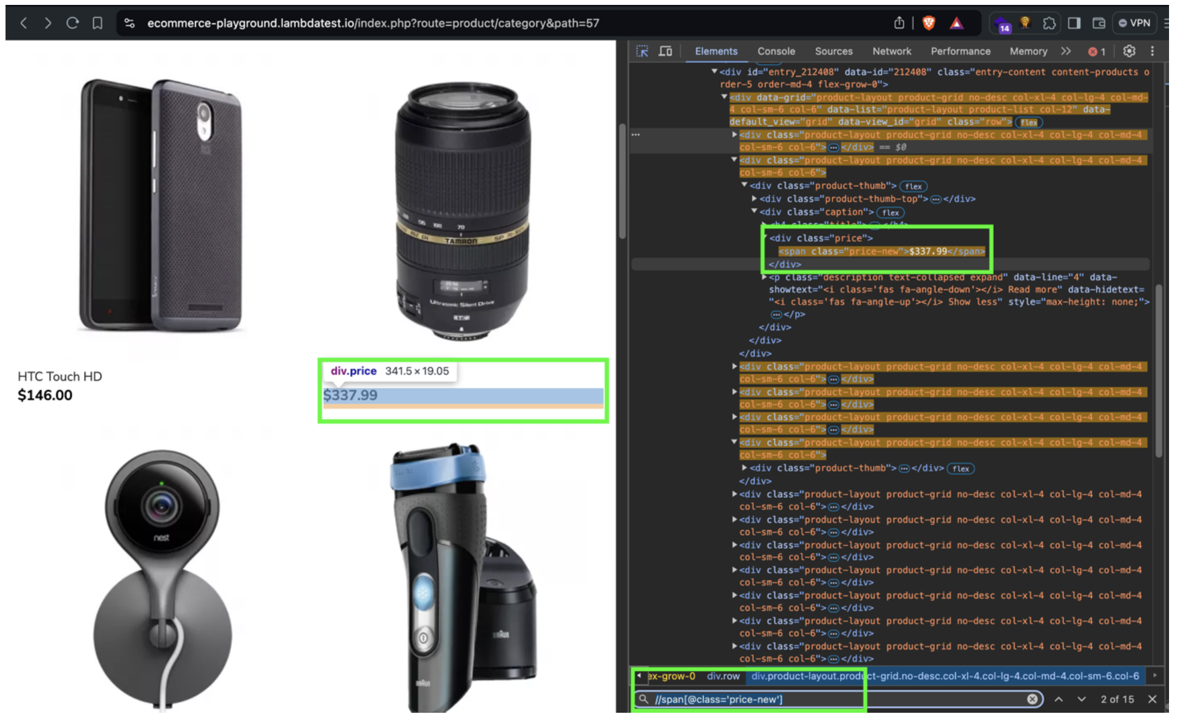
Select the Product Price

Slide 21
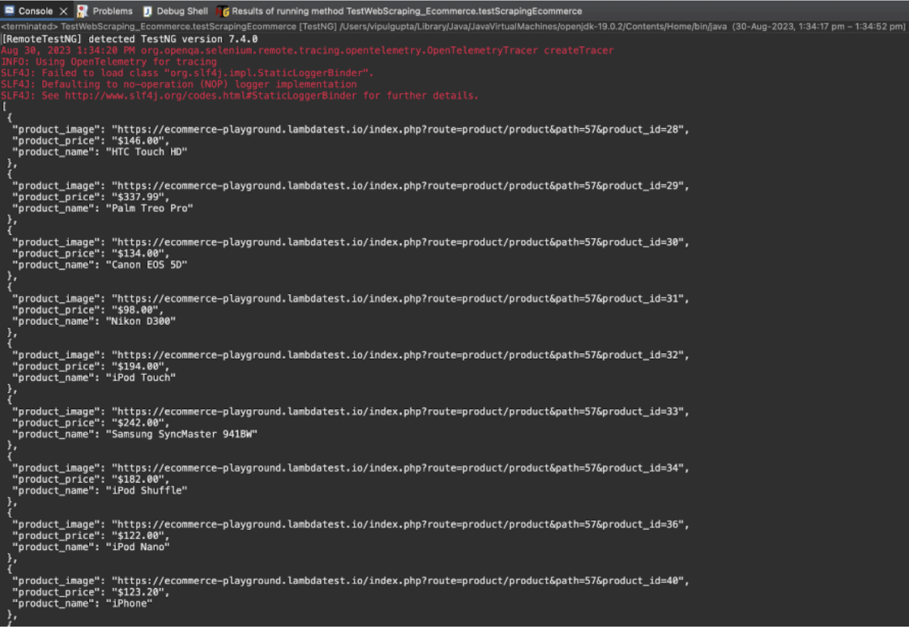
Console Output

Slide 22
THANK YOU!!!

